Slide 1
Political science introductory course
Lecture 7
Marem Buzurtanova
Almaty 2022
Al-Farabi KazNU

Slide 2
Lecture 7: Political Science: Qualitative Research Methods
The lecture covers the following:
1. Research Process:
1.1. Research Problem (question, hypothesis);
1.2. Research Design;
1.3. Data Collection, Processing, Displaying;
1.4. Writing.
2. Qualitative Research:
2.1. Observation;
2.2. Interview;
2.3. Case Study;
2.4. Questionnaire;
2.5. Oral History.

Slide 3
Lecture 7: Political Science: Qualitative Research Methods
Research Process:
Research is an endeavor to find the answers to the specific question(s) and/or test a hypothesis:
1. undertaken within a methodological (paradigmal) framework;
2. procedures, methods and techniques with their validity and reliability tested and proved;
3. unbiased and objective.
Research Characteristics:
Controlled, rigorous, systematic, valid, verifiable, empirical, critical.

Slide 4
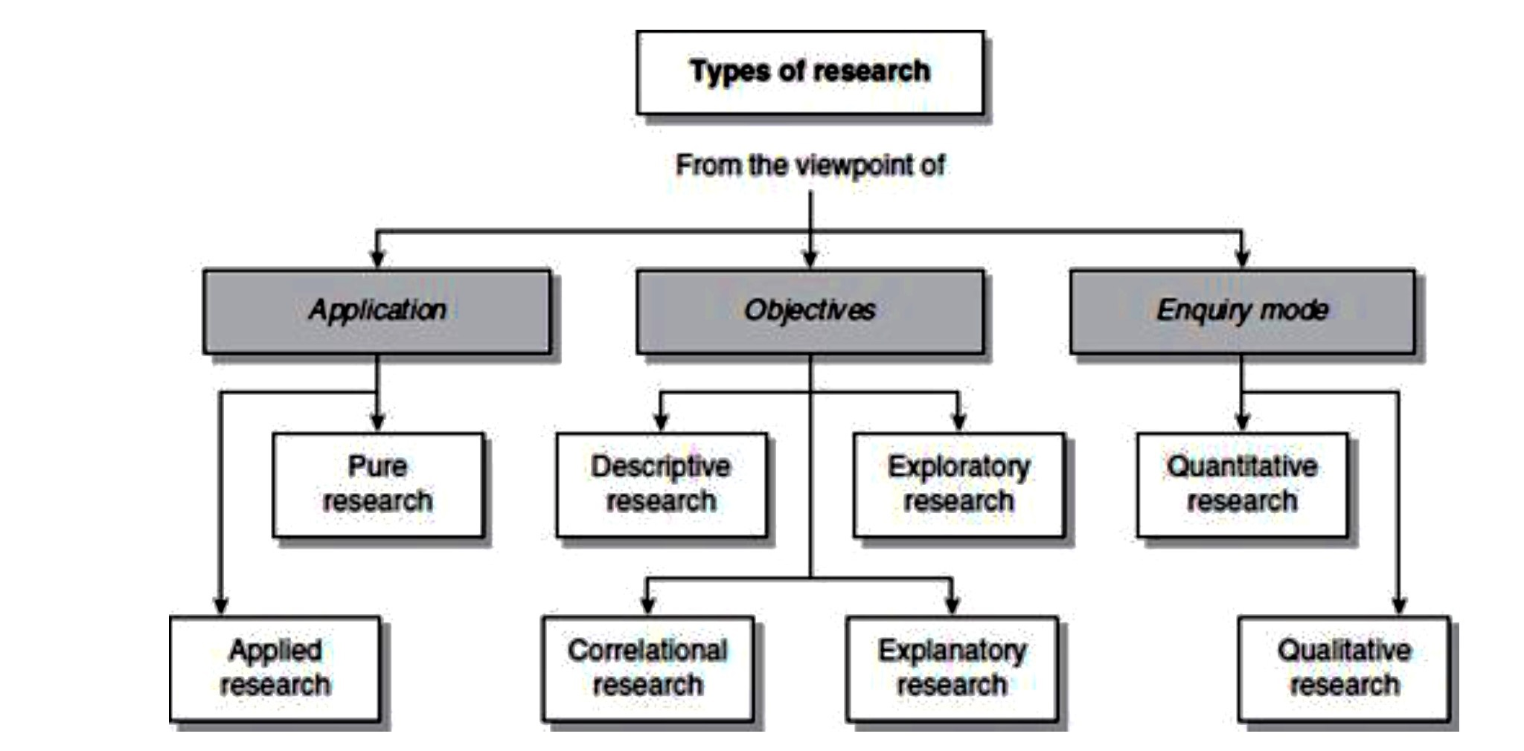
Lecture 7: Political Science: Qualitative Research Methods

Slide 5
Lecture 7: Political Science: Qualitative Research Methods
eight-step model for carrying out research
PHASE I DECIDING WHAT TO RESEARCH
Step I Formulating a research problem
PHASE II PLANNING A RESEARCH STUDY
Step II Conceptualizing a research design
Step III Constructing an instrument for data collection
Step IV Selecting a sample
Step V Writing a research proposal
PHASE III CONDUCTING A RESEARCH STUDY
Step VI Collecting data
Step VII Processing and displaying data
Step VIII Writing a research report

Slide 6
Lecture 7: Political Science: Qualitative Research Methods
Research Problem (question, hypothesis):
Formulating research problem;
Developing preliminary hypothesis;
Literature review;
Identifying variables;
Final hypothesis;
Research design.
Hypothesis is a supposition or proposed explanation made on the basis of limited evidence as a starting point for further investigation.

Slide 7
Lecture 7: Political Science: Qualitative Research Methods
Considerations in selecting a research problem:
Interest;
Magnitude;
Measurement of concepts;
Level of expertise;
Availability of data;
Ethical issues.

Slide 8
Lecture 7: Political Science: Qualitative Research Methods
2. Qualitative Methods:
2.1. Observation;
2.2. Interview;
2.3. Case Study;
2.4. Questionnaire;
2.5. Oral History.

Slide 9
Lecture 7: Political Science: Qualitative Research Methods
Quantitative Research, Observation:
Participant observation is another strategy for gathering information about a social interaction or a phenomenon in qualitative studies, usually done by developing a close interaction with members of a group or ‘living’ in the situation which is being studied. In qualitative research, an observation is always recorded in a descriptive format.

Slide 10
Lecture 7: Political Science: Qualitative Research Methods
Interview:
- Individual and/or focus group;
- Structural and/or unstructured.

Slide 11
Lecture 7: Political Science: Qualitative Research Methods
Case Study:
The case study is a qualitative study design. A case could be an individual, a group, a community, an instance, an episode, an event, a subgroup of a population, a town or a city. There are typical or atypical cases.
To test hypothesis;
To build theory.

Slide 12
Lecture 7: Political Science: Qualitative Research Methods
Questionnaire (Survey):
A questionnaire is a research instrument consisting of a series of questions (or other types of prompts) for the purpose of gathering information from respondents. The questionnaire was invented by the Statistical Society of London in 1838.
Who to question;
How to question;
Why to question.

Slide 13
Lecture 7: Political Science: Qualitative Research Methods
Oral History:
More a method of data collection than a study design; in qualitative research it has become an approach to study perceptions, experiences and accounts of an event or gathering historical knowledge as viewed by individuals. It is a picture of something in someone’s own words.
Oral history is a process of obtaining, recording, presenting and interpreting historical or current information, based upon personal experiences and opinions of some members of a study group or unit.
These opinions or experiences could be based upon eye-witness evidence or information passed on from other sources such as older people, ancestors, folklore, stories.

